Slide 2


Towards Financial Inclusion (FI)
Using survey data to assess FI status of the Philippines
Sprint 1, Sept 2022
Rick Aaron Sta.Clara
Notes:
Image: https://oi-files-cng-prod.s3.amazonaws.com/asia.oxfam.org/s3fs-public/styles/full-width-670x335-2_1/public/OGB_120684_Ruth,%20Davos%202020,%20Inequality.jpg?itok=Dm-D9WIN

Slide 3
SPRINT TIMELINE
 | MONDAY | TUESDAY | WEDNESDAY | THURSDAY | FRIDAY | SATURDAY
Week 1 | Sprint Overview Pandas: Basic data wrangling techniques | Pandas: Advanced data wrangling techniques | Data visualization Introduction to Streamlit | Lab activity: Exploratory Data Analysis | Data storytelling Creating your own Streamlit web page Mentor-free day | Review of Week 1
Week 2 | Introduction to Machine Learning Clustering | Introduction to Linear Regression and Logistic Regression Mentor-free day | Introduction to deployments Deployment using Streamlit Cloud and Hugging Face Spaces | Sprint Project Prep Day 1 | Sprint Project Prep Day 2 | Sprint Presentation

Slide 4
DAY 3 AGENDA
RECAP
01
DATA VISUALIZATION IN PYTHON
02
INTRODUCTION TO STREAMLIT
03

Slide 5
01
RECAP

Slide 6
02
DATA VISUALIZATION IN PYTHON

Slide 7
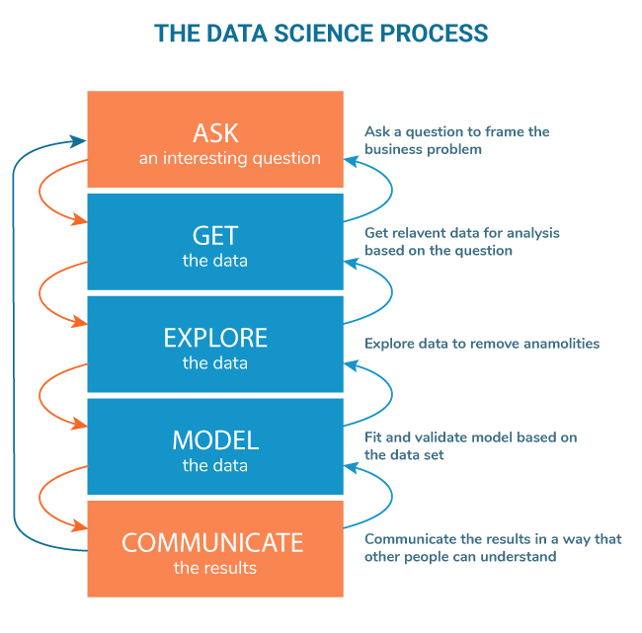
Data visualization
Now, you know how to wrangle the data. What’s next?

Slide 8
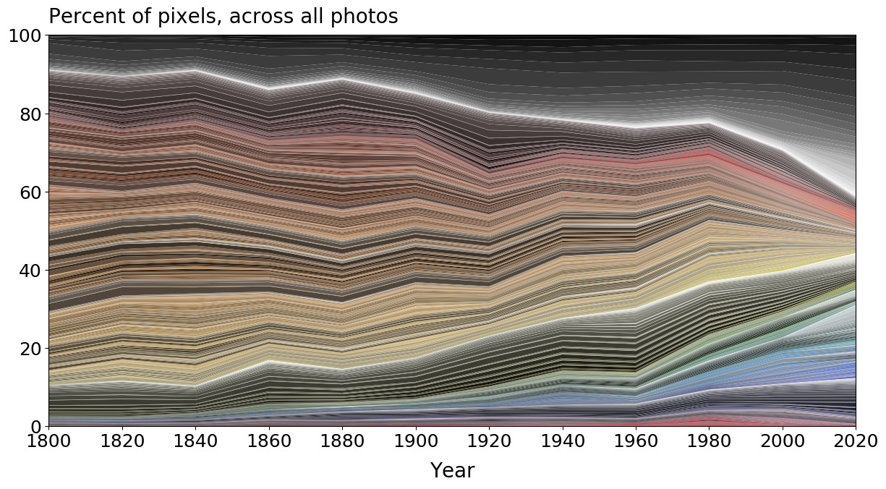
Data visualization
In the whole data science process, communicating your results is the only component that your stakeholders will see. As much as data wrangling and interpreting your results is impactful, proper communication of your results is also equally important. It is an opportunity to recommend your insights and drive decisions!
Communicating your results can be done by presenting your data through data visualizations.

Slide 9
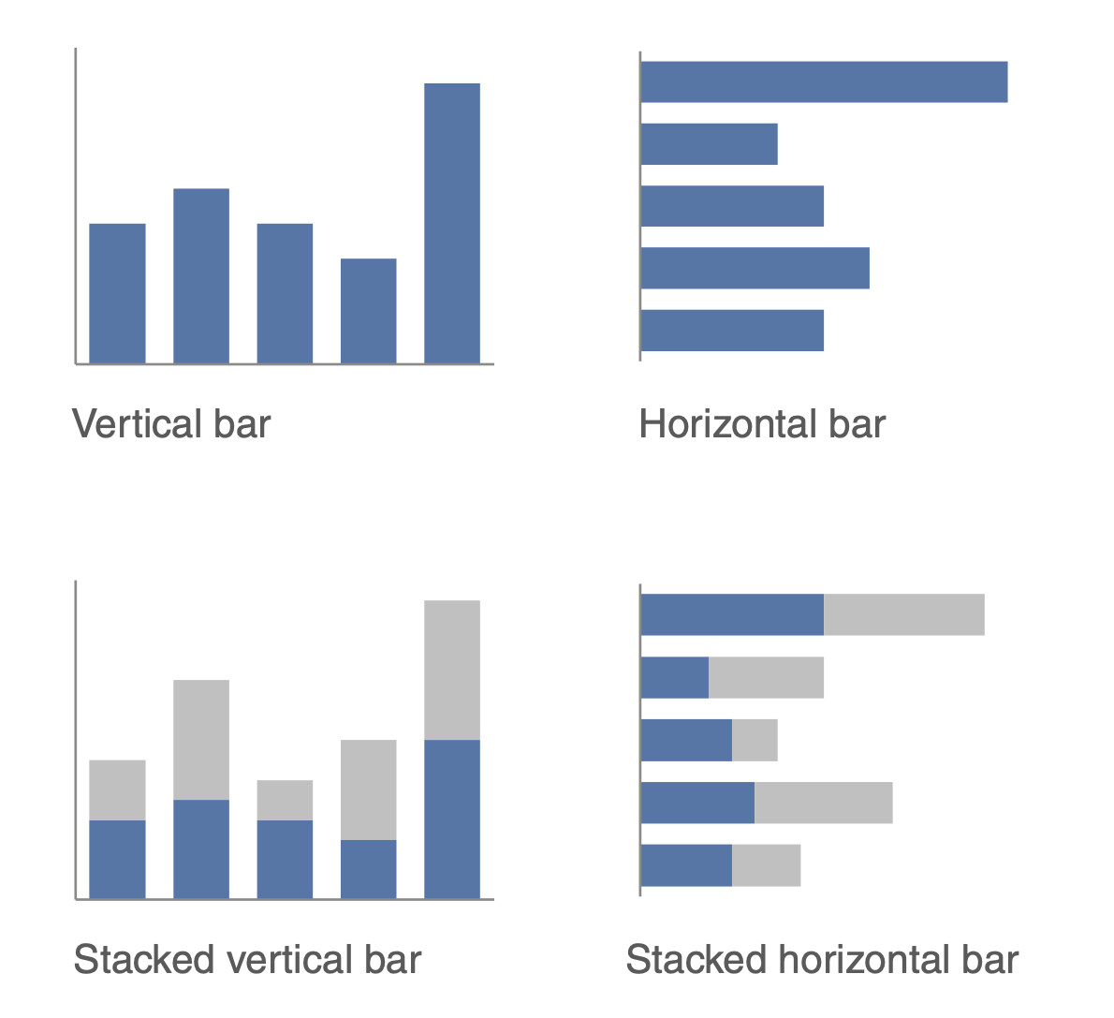
Common data viz charts
Bar charts

Slide 10
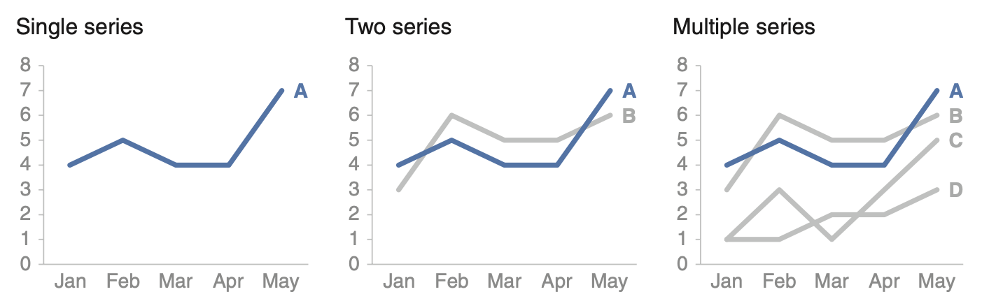
Common data viz charts
Line charts

Slide 11
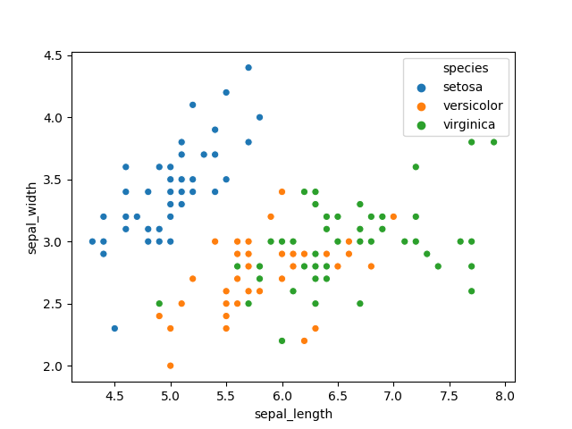
Common data viz charts
Scatterplot

Slide 12
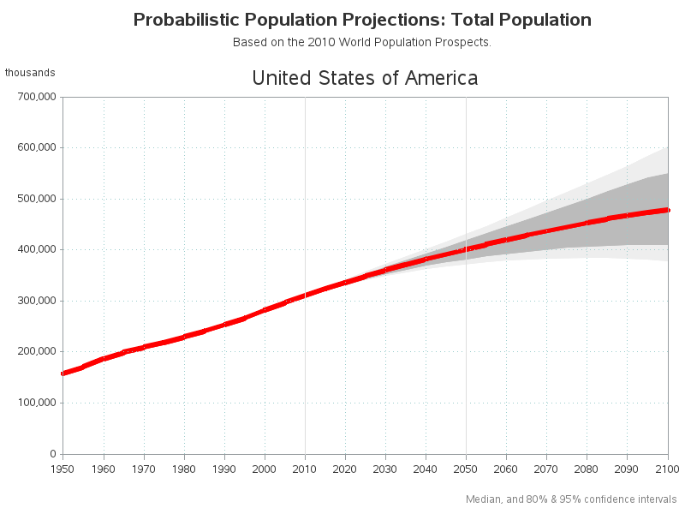
Common data viz charts
Line chart with confidence intervals

Slide 13
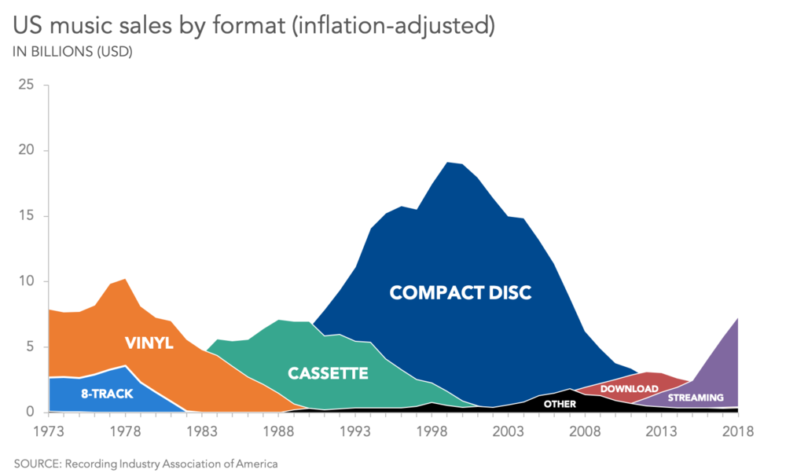
Common data viz charts
Area charts
Side question: why use area charts vs line charts? 🤨

Slide 14
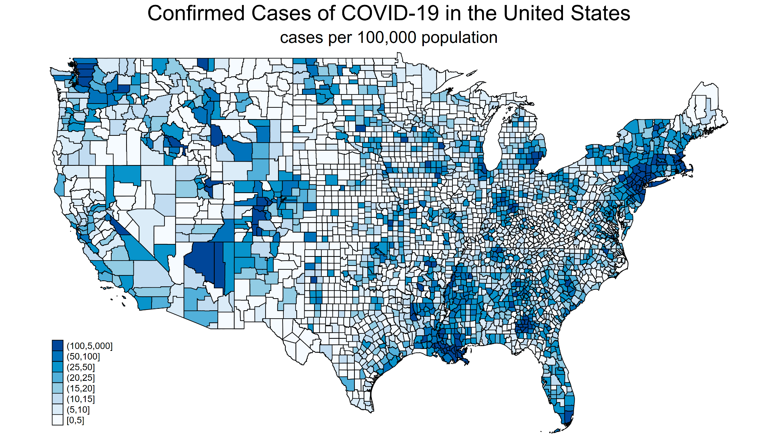
Common data viz charts
Choropleth map

Slide 15

PANDAS
pandas is a fast, powerful, flexible and easy to use open source data analysis and manipulation tool, built on top of the Python programming language.
*Description from https://pandas.pydata.org/

Slide 16


Matplotlib is a comprehensive library for creating static, animated, and interactive visualizations in Python. Inspired by MATLAB-style plots.
*Description from https://matplotlib.org/devdocs/index.html
Seaborn is a Python data visualization library based on matplotlib. It provides a high-level interface for drawing attractive and informative statistical graphics.
*Description from https://seaborn.pydata.org/

Slide 17

The plotly Python library is an interactive, open-source plotting library that supports over 40 unique chart types covering a wide range of statistical, financial, geographic, scientific, and 3-dimensional use-cases.
In our case, we will use plotly for geospatial mapping.
*Description from https://plotly.com/python/getting-started/

Slide 18
LET’S CODE!
This is going to be a code-along session. If you can’t follow, feel free to open your mic and interrupt. You may also ask your mentors for help. Again, encountering errors is natural. 😁

Slide 19
ACTIVITY. In breakout rooms, load & explore the FI survey dataset (micro_world.csv). Try to do the following. Discuss findings with the rest of your group.
AVERAGE. Create a bar chart of top 10 countries in terms of % of females with debit card.
DIFFICULT. Create a bubble map to show % of females with debit card per country. Create another showing % of males with debit card per country.
Allotted time: 30 minutes
Notes:
http://mathcenter.oxford.emory.edu/site/math117/shapeCenterAndSpread/

Slide 20
03
INTRODUCTION TO STREAMLIT

Slide 21
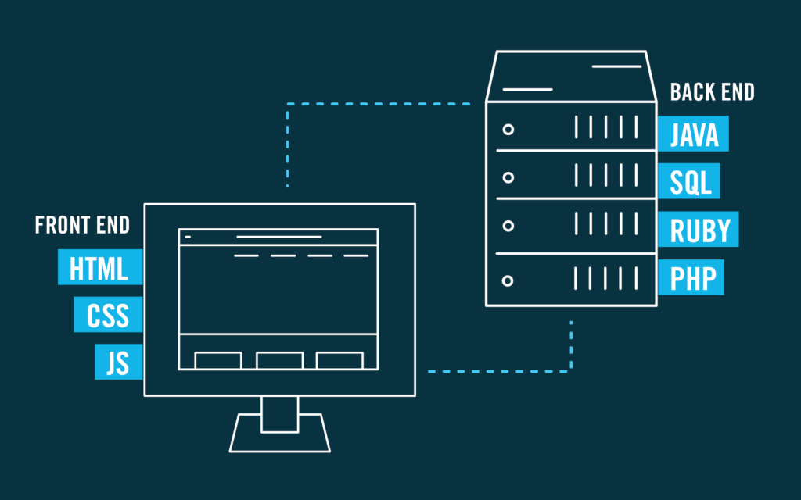
Creating a web application
When you want to “deploy” your dashboard or machine learning model to your stakeholders for consumption, you might be asked to create a web app. Note that creating a web app is usually done in two parts: (1) prototyping in your local (i.e. creating the components in your OWN computer and (2) deploying to production (i.e. deploying your code in a virtual machine so other people can access and use it).
Creating a web app is a process of creating various moving components which can be broadly categorized into two major parts: the front-end and the back-end.

Slide 22

Let there be… Streamlit!
Streamlit is an open-source Python library that makes it easy to create and share beautiful, custom web apps for machine learning and data science. In just a few minutes you can build and deploy powerful data apps.
*Description from https://docs.streamlit.io/.

Slide 23
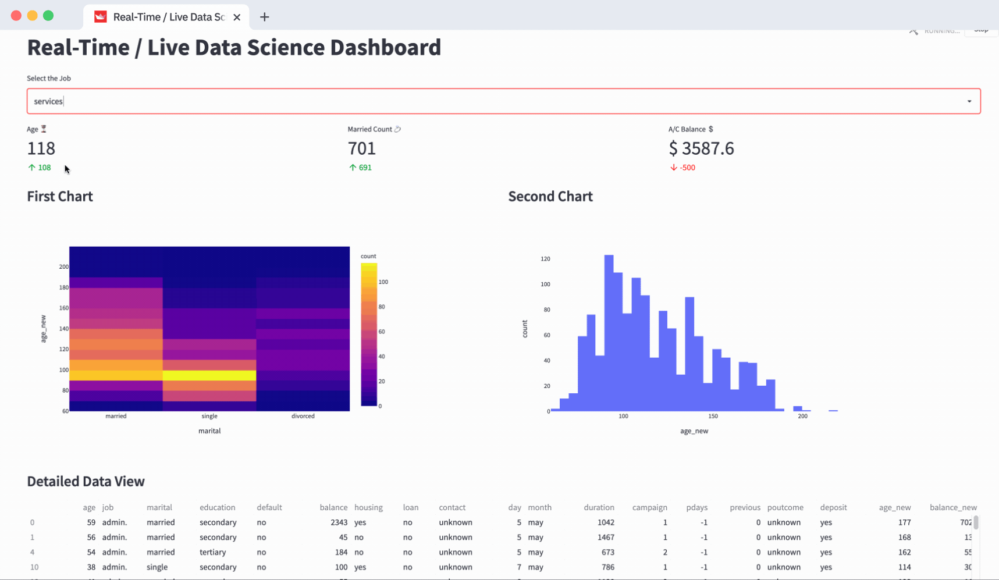
Let there be… Streamlit!

Slide 24



Installation of text editors
When we do prototyping, we usually use Jupyter notebooks (.ipynb).
When we do scripting (.py), we usually transition to text editors like Sublime, PyCharm or VS Code.
Scripting is a series of editing your code and running your script via the terminal to see if the code works as expected.
Don’t be overwhelmed, this is just a TEXT EDITOR.

Slide 25
LET’S CODE!
This is going to be a code-along session. If you can’t follow, feel free to open your mic and interrupt. You may also ask your mentors for help. Again, encountering errors is natural. 😁

Slide 26
ACTIVITY. In breakout rooms, load & explore the FI survey dataset (micro_world.csv). Try to do the following. Discuss findings with the rest of your group.
Install scripting programs (you may use Sublime, PyCharm or VS Code).
Run the template Streamlit template application.
If you want to play around with Streamlit, use the reference: https://docs.streamlit.io/library/api-reference.
Allotted time: 20 minutes
Notes:
http://mathcenter.oxford.emory.edu/site/math117/shapeCenterAndSpread/

Slide 27
TAKE-HOME READING:
How to Spot Visualization Lies
By Nathan Yau
Ask:
What are the common data visualization mistakes people make? Was it intentional?
Notes:
http://mathcenter.oxford.emory.edu/site/math117/shapeCenterAndSpread/

Slide 28
End of Sprint 1 Day 3
Any questions?

